Slide 1
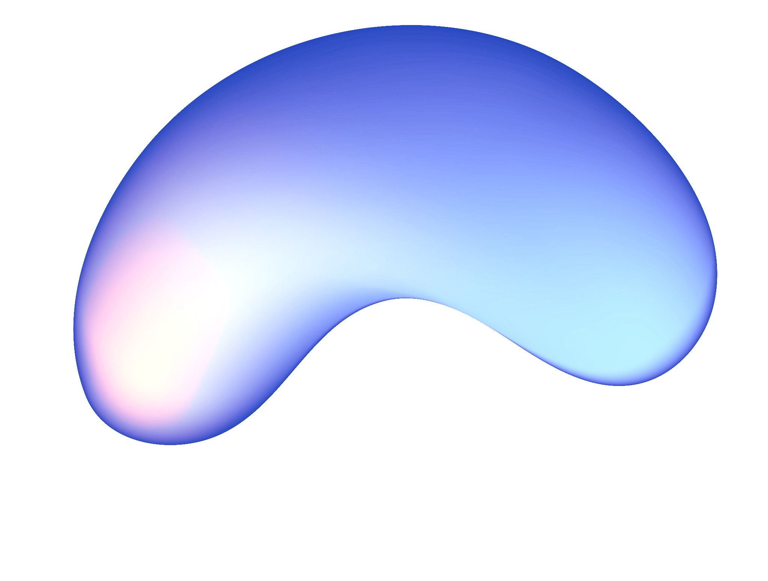
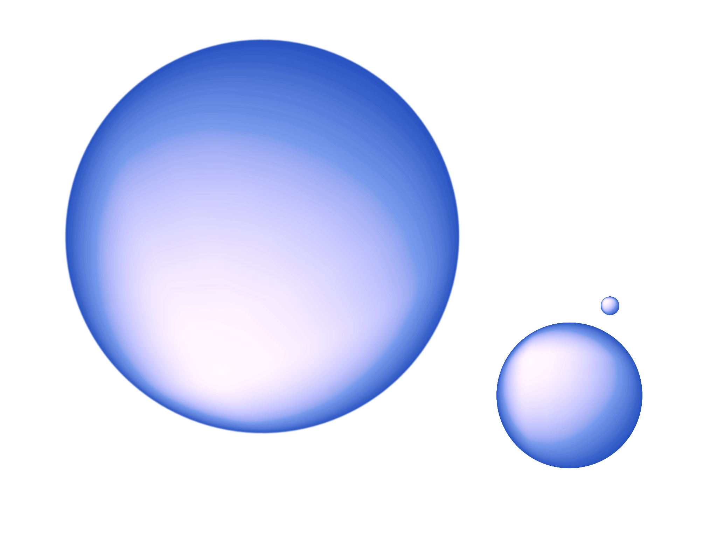
SHAKESPEARE RNN MODEL
SHAKESPEARE
RNN MODEL
NICHOLAS REVENCO

Slide 2
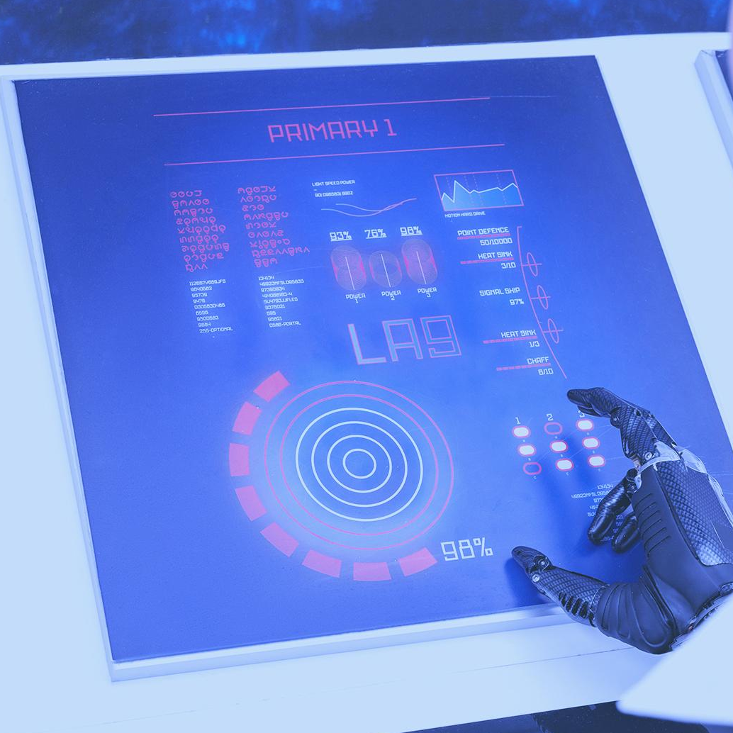
RECURRENT NEURAL NETWORK
- Recurrent Neural Networks (RNNs) allow bi-directional information flow, unlike unidirectional feedforward networks.
- They use internal memory to process sequence inputs, useful for tasks like speech recognition.
- RNNs stand out for their ability to 'remember' and predict based on past inputs in a sequence.
- RNNs are Turing complete, capable of executing any program for any input sequence.

Slide 3
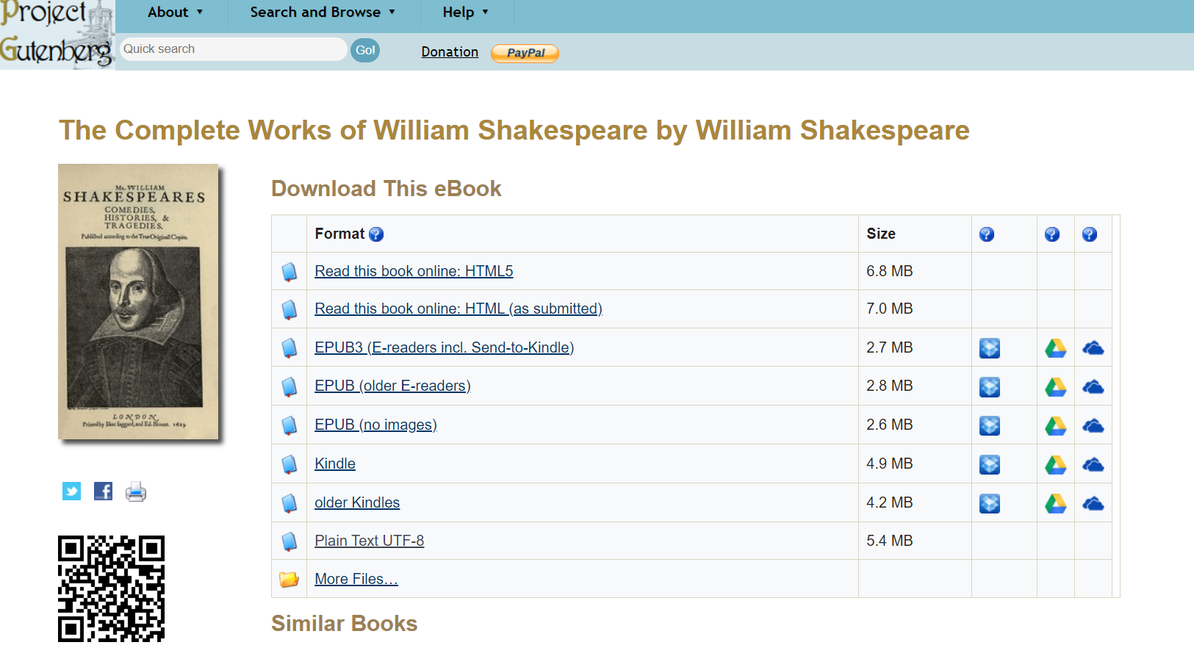
SHAKESPEARE DATASET
- Data Source: The dataset is derived from the Gutenberg Project, a vast resource of diverse literary works.
- Dataset Composition: It includes all of Shakespeare's works, offering a wide range of language patterns for training.
- Dataset Size: The dataset is substantial, with over 5 million characters (over 1 million words), providing a robust training base.
- Training Duration: The model was trained for 3.5 hours, a significant timeframe contributing to its performance.

Slide 4
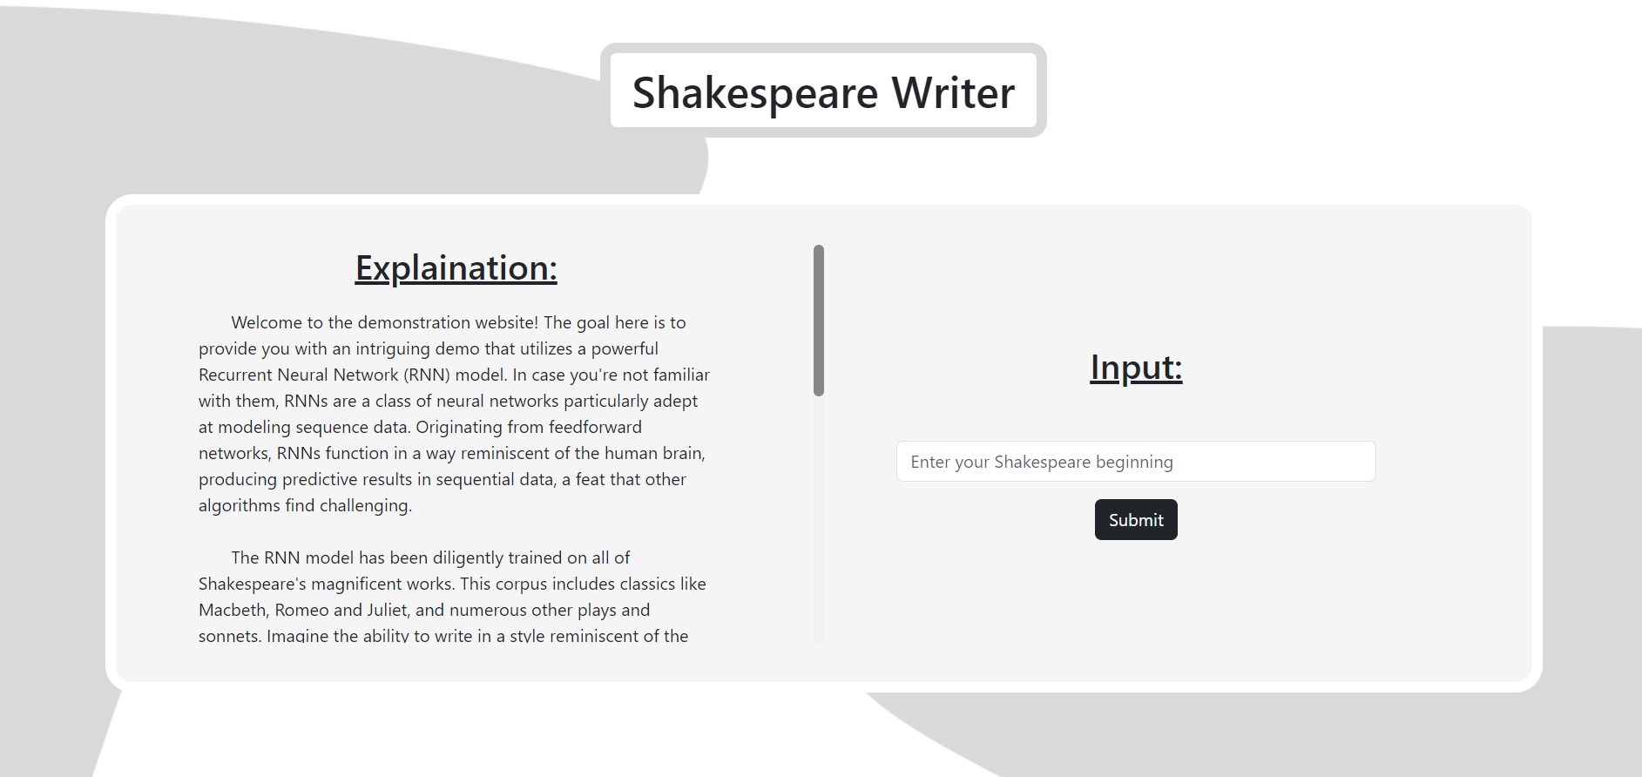
GOOGLE COLAB WEBSITE EXPERIENCE
- Tool Used: The project utilized Google Colab, a cloud-based Python coding service.
- Unique Implementation: Websites hosted on Google Colab are uncommon, making this project distinctive.
- Model Utilization: The model functions as a prompt generator, expanding on inputted text.
- User Interaction**: Users can interact with the model by providing text inputs.
- Practical Application: This showcases real-world AI implementation via an accessible interface.

